Slide 1

Unit 3: Friends
Lesson 2

Slide 2

New words

Slide 3
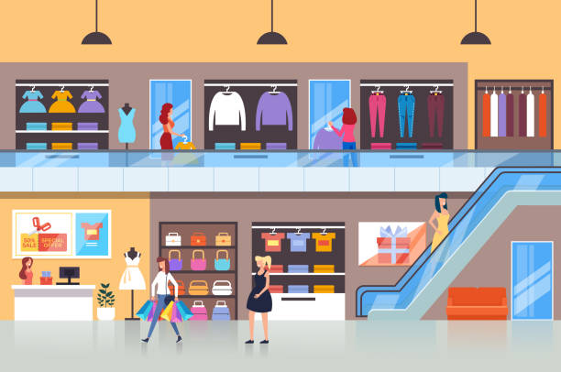
mall
(n) Trung tâm mua sắm

Slide 4
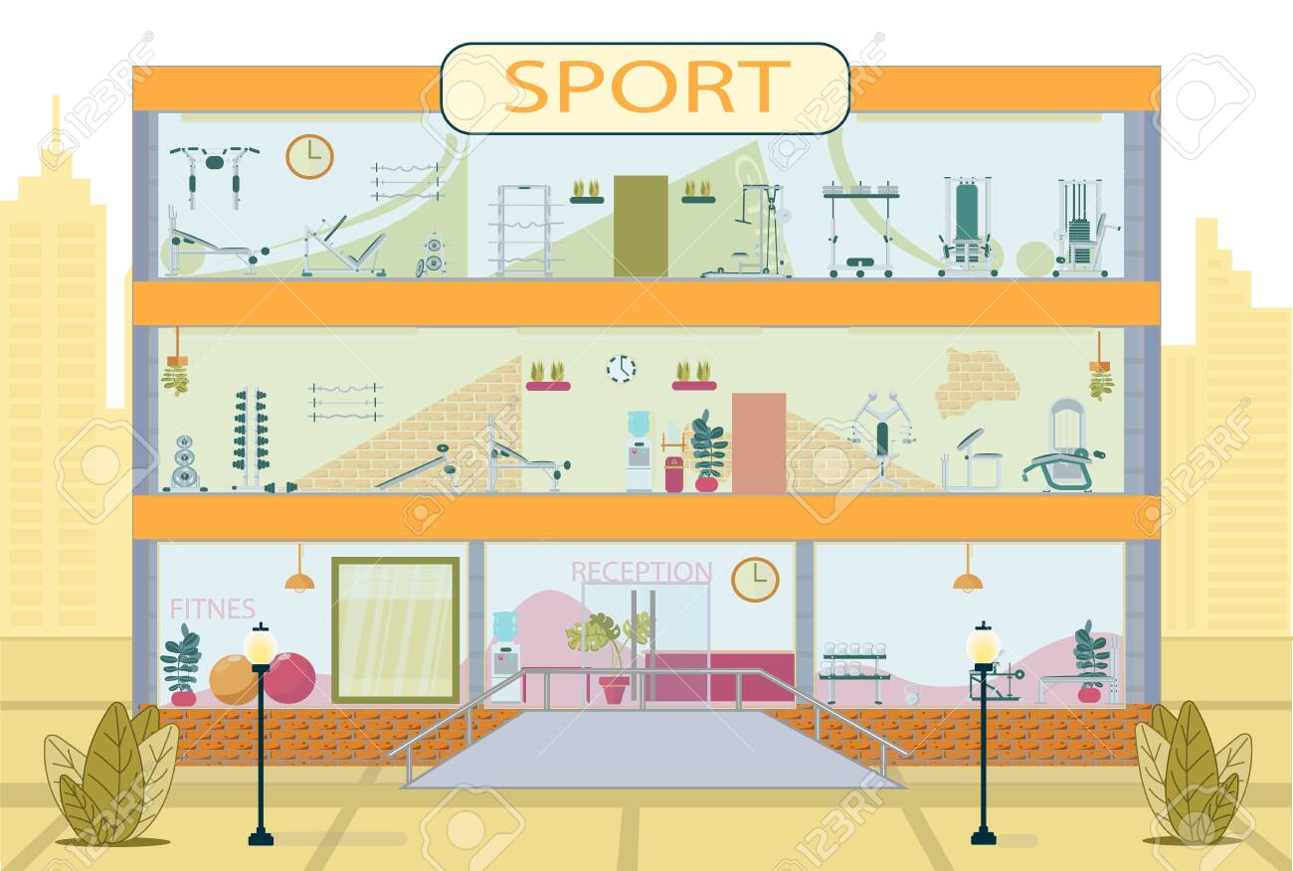
Sport center
(n) Trung tâm thể thao

Slide 5
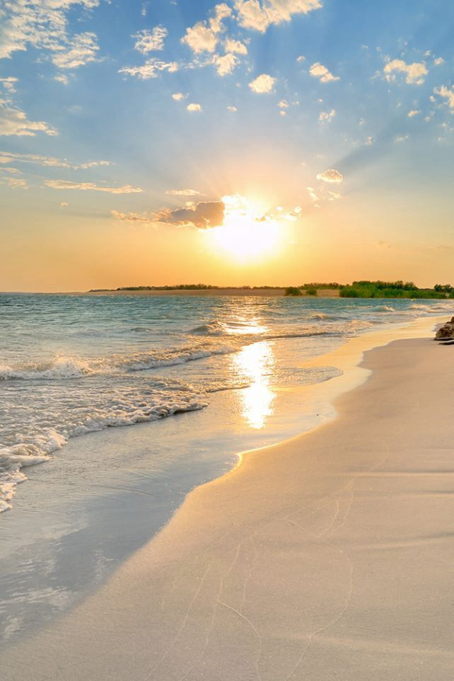
Beach
(n) Bãi biển

Slide 6
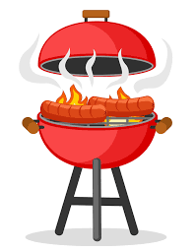
barbecue
(n) thịt nướng

Slide 7
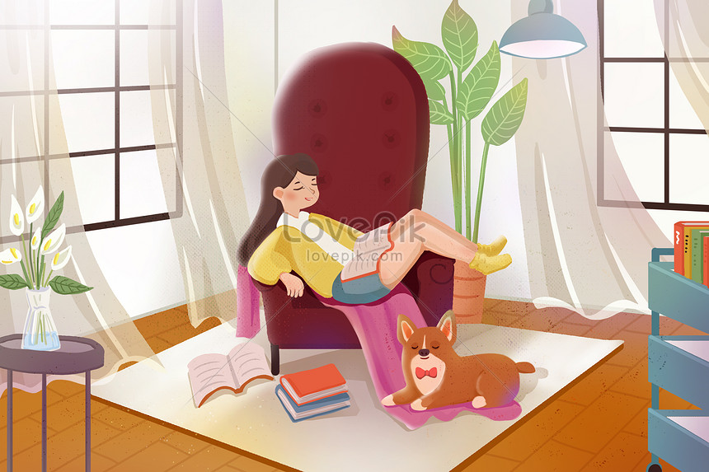
free
(adj) rãnh rỗi

Slide 8
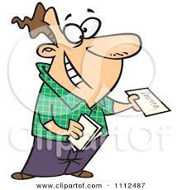
invite
(n) mời

Slide 9

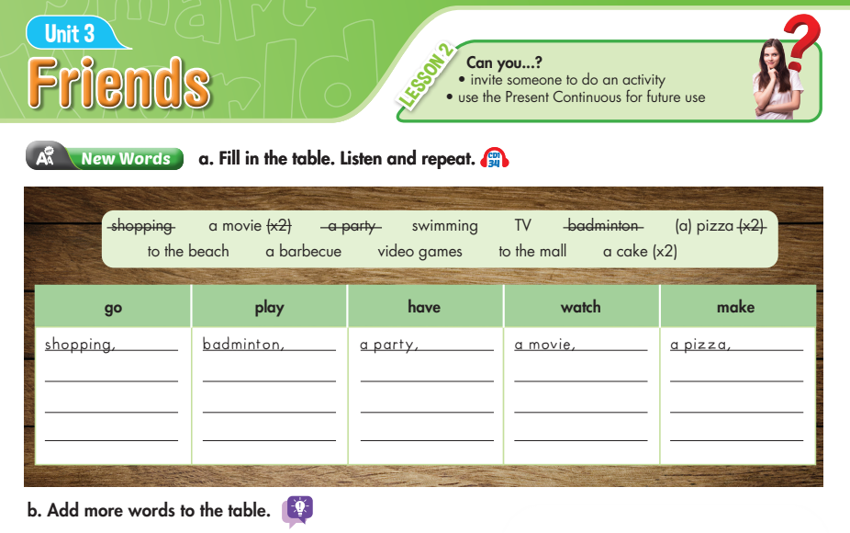
Lesson 2

Slide 10
Lesson 2
swimming,
video game
a pizza,
a TV
a cake,
to the mall,
a barbecue,
a movie
to the beach
a cake,

Slide 11
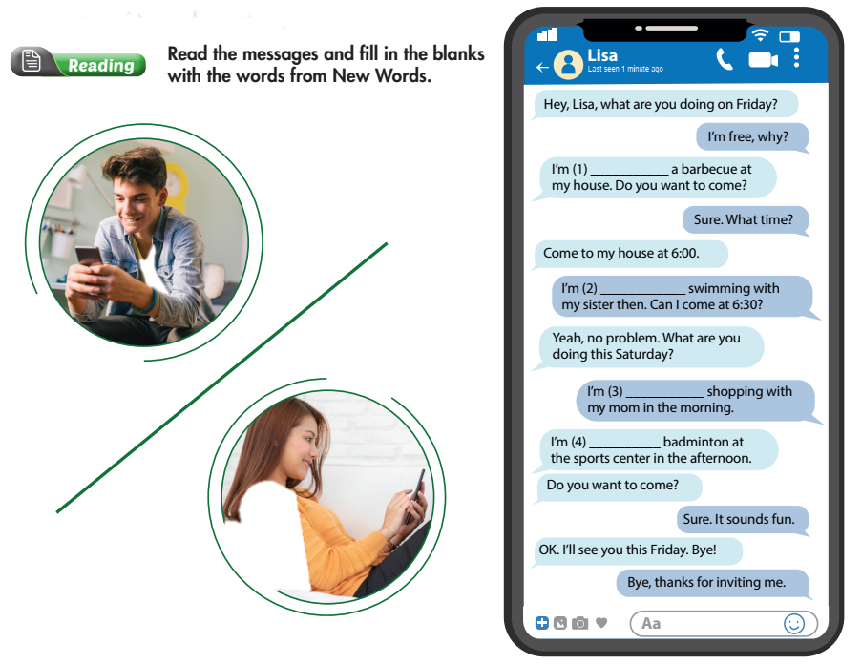
Lesson 2
having
going
going
playing

Slide 12
Ngữ pháp: Thì hiện tại tiếp diễn với nghĩa tương lai
- The present continuous with future meaning
1. Cấu trúc chung: S + am/ is/ are + V-ing
2. Cách sử dụng:
Thì hiện tại tiếp diễn được dùng diễn tả sự sắp xếp hay kế hoạch trong tương lai, thường có từ chỉ thời gian như : tomorrow, on the next weekend, tonight( với ngữ cảnh tối nay chưa tới)....
E.g.: They're building a new school next year.
(Năm tới họ sẽ xây một trường học mới.)
What are you doing this coming weekend?
(Ngày cuối tới này, bạn làm gì)

Slide 13
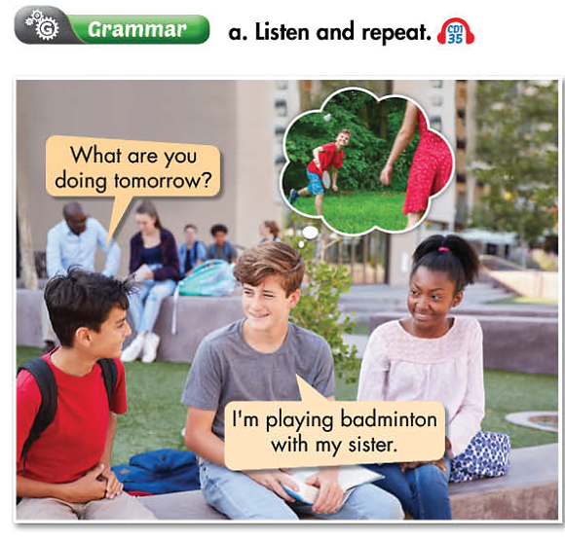

Slide 14
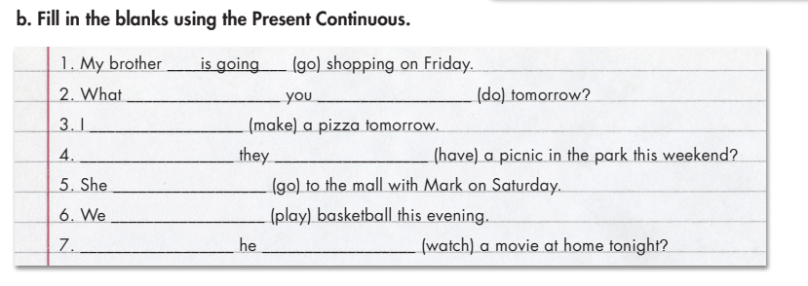
Lesson 2
are
doing
am making
Are
having
is going
are playing
Is
watching

Slide 15
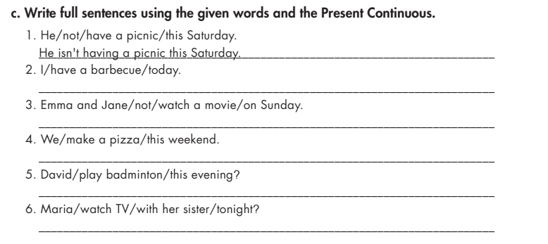
Lesson 2
I am having a barbecue today.
Emma and Jane are not watching a movie on Sunday.
We are making a pizza this weekend.
Is David playing badminton this evening?
Is Maria watching TV with her sister tonight?

Slide 16
Exercises:

Slide 17
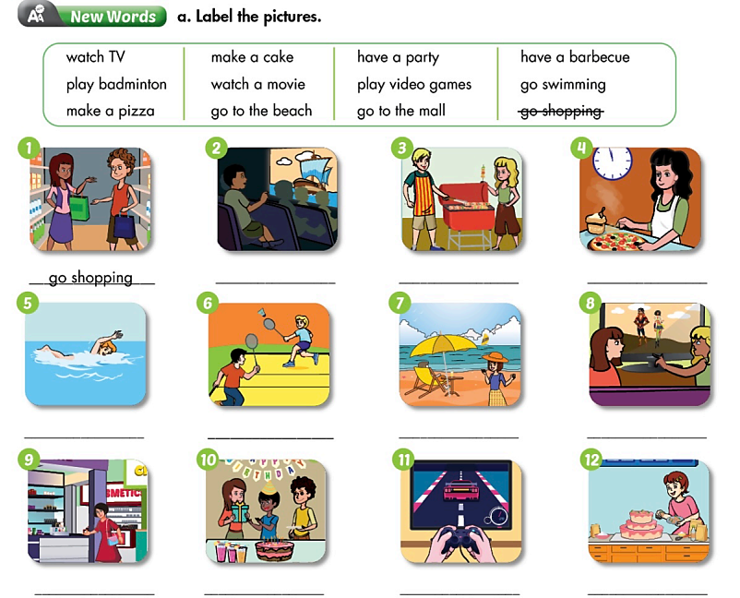
Bài tập 1

Slide 18
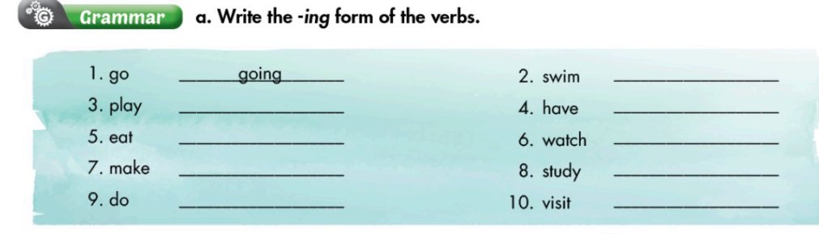
Bài tập 2

Slide 19
Bài tập 3: chọn phương án đúng
1. Have you got an umbrella? It ……………………… to rain.
a. is starting b. are starting c. am starting d. start
2. You ……………….. a lot of noise. Can you be quieter? I …………… to concentrate.
a. is makeing/am trying b. are makeing/ am trying
  c. are making/ am trying d. is making/ am trying
3. Why are all these people here? What ……………………. ?
  a. am happening b. are happening c. is happening d. is happening
4. Your English …………….. . How do you learn?
  a. is improving b. are improving c. improve d. improving
5. Please don’t make so much noise. I ………………… to work.
  a. is trying b. are trying c. trying d. am trying

Slide 20
6 You can turn off the radio. I …………. to it.
a. are not listening b. isn’t listening
c. am not listening d. don’t listening
7. They …………………… the artificial flowers of silk now?
  are………. makeing b. are……… making
c. is……….. makeing d. is ……….. making
8. I want to lose weight, so this week I ……………. lunch.
a. am not eating b. isn’t eating c. aren’t eating d. amn’t eating
9 Listen! The teacher …………………..a new lesson to us.
a. is explaining b. are explaining c. explain d. explains
10. They ………… …….. tomorrow.
a. are coming b. is coming c. coming d. comes

Slide 21
Đáp án gợi ý Bài tập 3:
1. Have you got an umbrella? It ……………………… to rain.
a. is starting b. are starting c. am starting d. start
2. You ……………….. a lot of noise. Can you be quieter? I …………… to concentrate.
a. is makeing/am trying b. are makeing/ am trying
  c. are making/ am trying d. is making/ am trying
3. Why are all these people here? What ……………………. ?
  a. am happening b. are happening c. is happening d. is happening
4. Your English …………….. . How do you learn?
  a. is improving b. are improving c. improve d. improving
5. Please don’t make so much noise. I ………………… to work.
  a. is trying b. are trying c. trying d. am trying

Slide 22
6 You can turn off the radio. I …………. to it.
a. are not listening b. isn’t listening
c. am not listening d. don’t listening
7. ........They …………………… the artificial flowers of silk now?
  are………. makeing b. are……… making
c. is……….. makeing d. is ……….. making
8. I want to lose weight, so this week I ……………. lunch.
a. am not eating b. isn’t eating c. aren’t eating d. amn’t eating
9 Listen! The teacher …………………..a new lesson to us.
a. is explaining b. are explaining c. explain d. explains
10. They ………… …….. tomorrow.
a. are coming b. is coming c. coming d. comes

